Slide 1
Product Overview

Slide 2
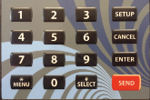
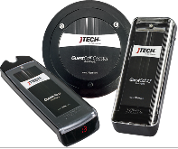
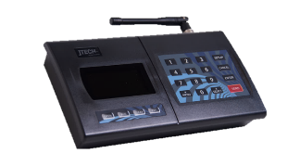
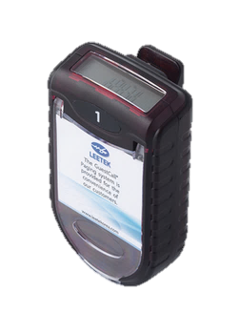

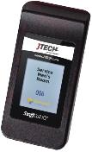
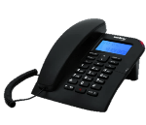
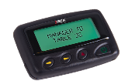
On-Site Paging System Basic Structure
Input Source
Paging Terminal
Receiver
Vibe only/
Tone Only
Direct Press /
Stand Alone
Numeric Pagers
PC/Software
(Serial/Ethernet)
Transmitter
Alpha Pagers
Tele-connect via
Telephone

Slide 3
How Our Systems Work
Our paging systems are made up of three basic components:
  Transmitter (Base Station)
    Transmitters send a message to a pager
      Entry is via a number keypad; computer keyboard; simple button press
  Pagers (Receivers)
    Pagers receive the message and alert.
      Receivers come in many form factors
      The main Message types are:
        Tone / flash / vibrate only , Numeric, Alpha
  Charger Kit (Charger with Power Supplies)
    Most pagers are rechargeable and need a place to charge
      Each system has its own charger form factor to match the pager.

Slide 4
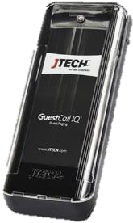
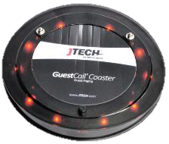
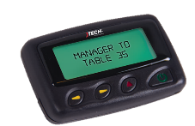
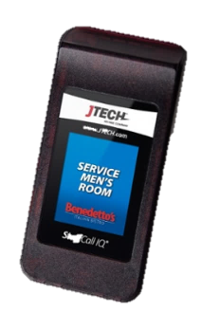
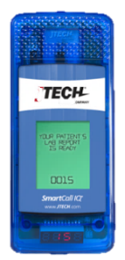
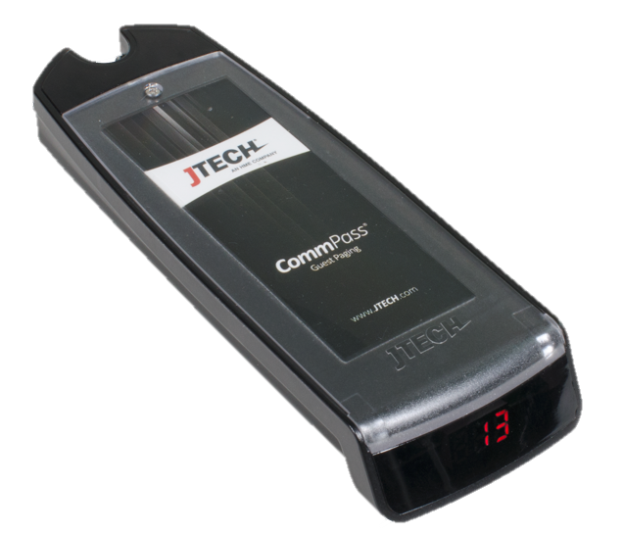
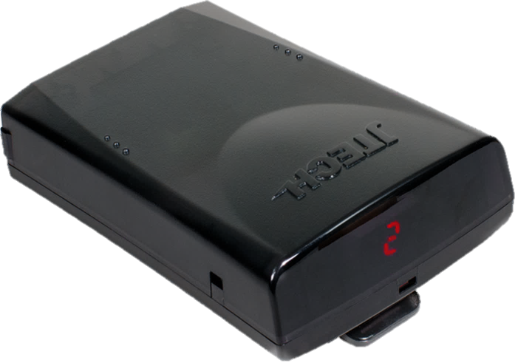
The Components
Pagers (Receivers)
Standard Functions
  Flash, Vibe, Tone & Voice
  Rechargeable NiMH Batteries
  Smart Charging
  Battery life of 2-4 years
  User replaceable battery packs
  Out-of-Range Alert function
IQ PAGER
COASTER PAGER
BATTERY OPERATED ALPHA PAGER
COMMPASS
PAGER
STAFF PAGER
SMARTCALL IQ
PAGER
RUGGED PAGER

Slide 5
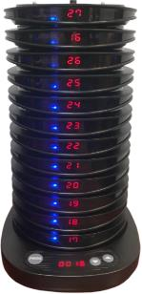
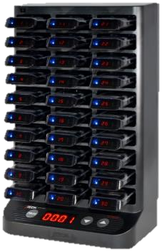
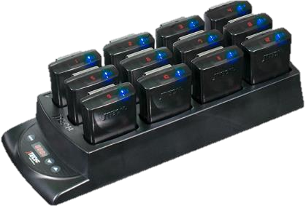
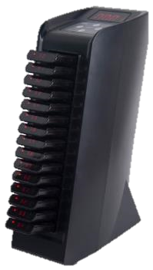
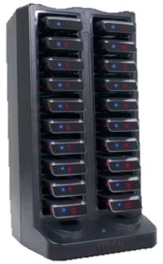
The Components
Chargers
Standard Functions
One power supply can charge a maximum of 60 pagers (all pagers except staff call pagers)
Chargers can be daisy chained using the jumper wires
Charger Power supply is rated 110 to 240 volts input
12 volts DC Output / 5 Amps
All chargers have Smart Charging feature to prevent batteries from over charging.
IQ CHARGER
COASTER CHARGER
RUGGED CHARGER
COMMPASS CHARGER
STAFFCALL CHARGER

Slide 6
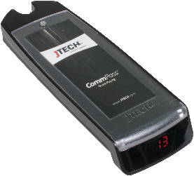



CommPass Pager
CommPass pagers are now digital. The redesigned CommPass makes a perfect entry-level guest paging system.
Features
Industry leading digital display eliminates the need for number decals.
Pagers can be re-numbered in seconds on site. No more duplicate pagers or missing number decals.
The ability to renumber on-site reduces the shipping costs.
Low battery indicator
”Smart Charging” avoids over-charging the battery and charges quickly in 2 hours.
Flash, vibrate, tone and voice alert options for personalization.
Replaceable Insert for advertisement
Part#: PGCPD1
LED Pager Number Display
Low Battery Indicator

Slide 7
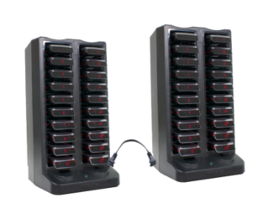
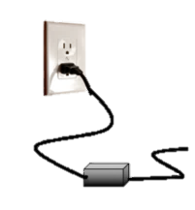
CommPass Charger Base
Part#: CHCP
Features
Green light power indicator
Charger base use the same power supply as the transmitter.
Charge Towers can be daisy chained using a jumper wire. Maximum of 3 chargers can be connected with one power supply.
Jumper
Wire
Power Indicator

Slide 8
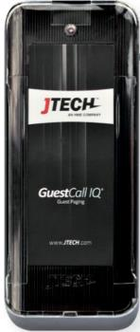
IQ Pager
Features
New Updated Design and Sleek Modern Look
Backwards compatible with IQ2008 pagers
Flash, vibrate and tone alert options for personalization.
Supports up to 9999 pagers
Put your own branded insert.
User replaceable batteries ensure limited down time.
Battery life indicator light shows battery is charging or needs replacing.
Out-of-range alert to reduce accidental loss.
Locate feature reduces loss and finds missing pagers.
IQ pager can be programmed either by over the air, charger or PC software
Part#: PGIQD

Slide 9
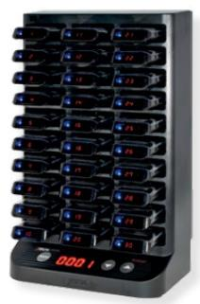
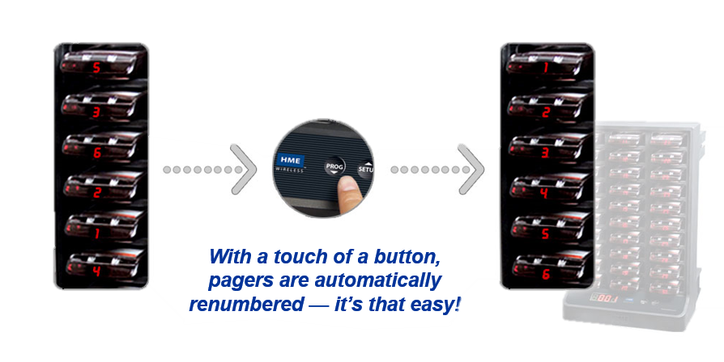
IQ Pager Charger Base
Features
With the touch of a button, our revolutionary, patent pending technology will automatically renumber all of your pagers at once.
Space-saving 30-position tower charger
Charges all pagers in 4 hours
Extends battery life without overcharging
Renumber pagers in seconds with a touch of a button.
Charger is backwards compatible with the old legacy IQ charger.
Part#: CHIQ

Slide 10
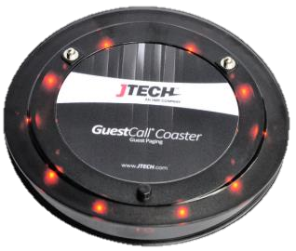
Coaster Pager
Features
New updated design and sleek modern look
Backwards compatible with Euro coasters and legacy coasters LT2008D
Flash, vibrate and tone alert options for personalization.
Use your own branded label.
User replaceable batteries ensure limited down time.
Battery life indicator light shows battery is charging or needs replacing.
Battery life is up to 3+ years.
Out-of-range alert to reduce accidental loss.
Locate feature reduces loss and finds missing pagers.
Coaster can be programmed either by over the air, charger or PC software
Part#: PGCST

Slide 11
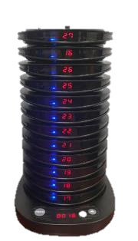
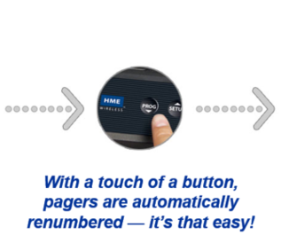
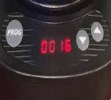
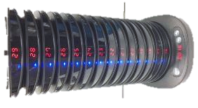
Coaster Charger Base
Features
First in the paging industry! Renumber 15 coasters in seconds with a touch of a button.
Charger is backwards compatible with the old legacy coaster charger. (won’t program)
“Smart Charging” avoids over-charging the battery and charges quickly in 4 hours.
Pagers can be programmed up to pager 9999
Part#: CHCST

Slide 12

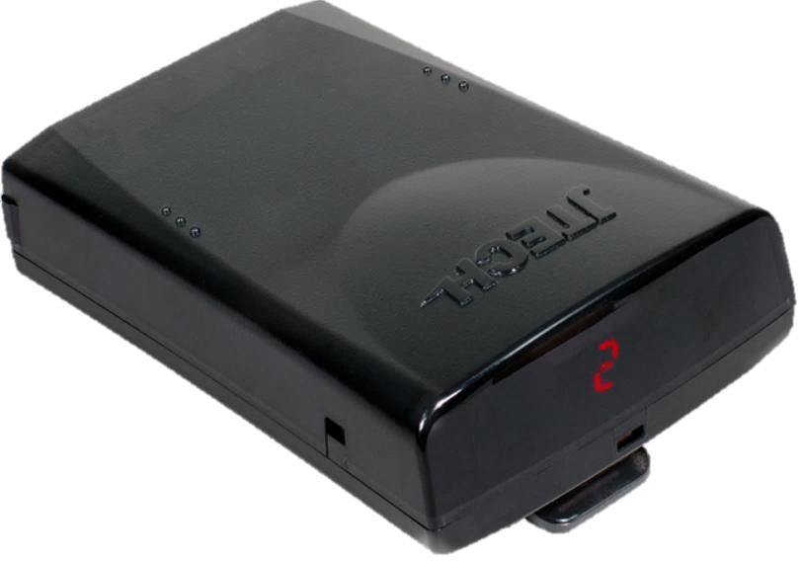
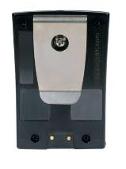
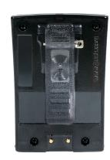
Rugged Pager
Features
New updated design and sleek modern look
Backwards compatible with legacy JTECH rugged and ServerPass pagers
Industry leading digital display eliminates the need for number decals.
Pagers can be re-numbered in seconds on site. No more duplicate pagers or missing number decals.
Flash, vibrate and tone alert options for personalization.
Battery life indicator light shows battery is charging or needs replacing.
Battery life is up to 3+ years.
Out-of-range alert to reduce accidental loss.
Locate feature reduces loss and finds missing pagers.
Pager can be programmed either by over the air, charger or PC software
2 clip options
Digital Pager
Display
Part#:
PGRGDM (w/ metal clip)
PGRGDS (w/ Spring Loaded Clip)
User Replaceable Clip
Metal Clip
Spring Loaded

Slide 13
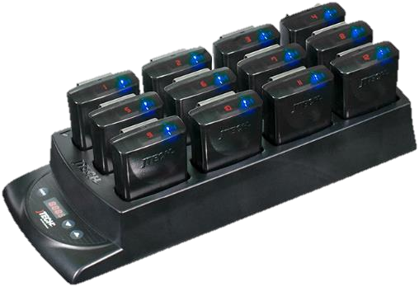
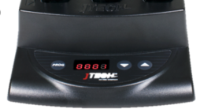
Rugged Charger Base
Features
First in the paging industry! Renumber belt pagers in seconds with a touch of a button.
Charger is backwards compatible with the old legacy rugged charger.
“Smart Charging” avoids over-charging the battery and charges quickly in 4 hours.
Pagers can be programmed up to pager 9999
Part#: CHRG

Slide 14
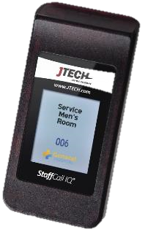
StaffCall Pager
Features
4 digit pager number capability
Full color TFT display (small font) - 16 characters/line x 7 lines
Upload your company logo for customization
Auto-numbering with charger
10 programmable canned messages available (text or graphics) -128 x 64 jpeg image size can be uploaded for canned messages
8 cap code storage
The charger allows for the ability perform the programming functions in bulk
Ability to change pager programming over the air, via charger, via micro USB connector or software
Ability to read and program the followings on the pagers by charger Base ID, Frequency, Alert type, alert time, SN and etc.
Part#: STFCHAR
Part#: STFIQ

Slide 15
Pager Programming
Three ways to program a JTECH pager
Using the PC programming software
  There are two new software versions
    Core Programming Software
    IQ Alpha Programming Software
Using the charger (except for CommPass pager)
Over the air programming

Slide 16
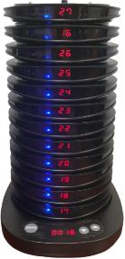
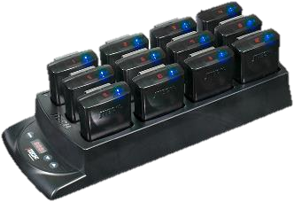


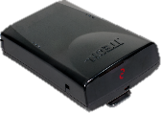

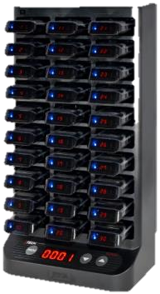
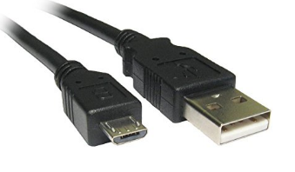

Pager Programming
Programming via Software – Setup
(Rugged, Coaster & IQ pagers)
Coaster Charger
Rugged Charger
Micro USB to Standard USB cable
IQ Charger
Micro USB to USB A

Slide 17

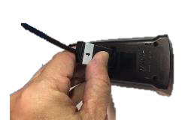
Pager Programming
Programming via Software – Setup
(Commpass Pager)
USB Programming
Adaptor
Commpass Rear side
COMMPASS
Programming
Probe

Slide 18
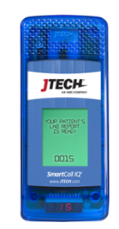
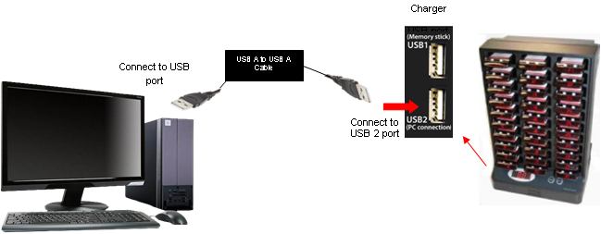
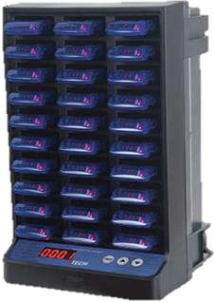
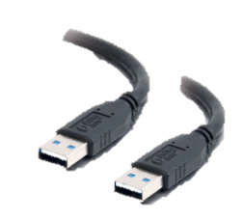
Pager Programming
Programming via Software – Setup
(Smartcall Alpha pagers)
Coaster Charger
USB A to USB A Cable

Slide 19
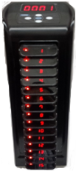
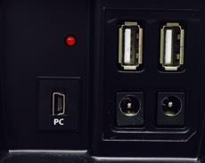
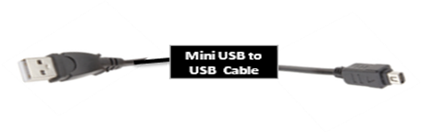
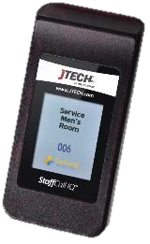

Pager Programming
Programming via Software – Setup
(Staffcall Pager)
Staff Pager Charger
USB port
Mini USB to USB A Cable

Slide 20

Pager Programming
Programming Software - Overview
Features
Windows 7 & 10 Compatible
7 Capcodes
Embedded End User ID Number to easily track where pagers came from.
Easy and Simple User Interface
Can program 30 pagers in less than a minute

Slide 21

IQ Alpha Pager Programming
PC Programming Software - Overview
Features
Windows 7 & 10 Compatible
8 Capcodes
  1 Individual Capcode
  7 Groups
Easy and Simple User Interface
Can program 30 pagers in less than a minute
Programmable canned messages…
  Alpha Text
  Images
Use your own logo or image on the pager display when it’s on standby mode.

Slide 22



Pager Programming
Programming Using a Charger
Accessing the programming menu (admin)
Unplug the power cord.
Press and hold the “PROG" and "▲" keys and plug in the power cord into the charger simultaneously.
Display will show “PROG” then will change to “Freq”.
Press "▲" to scroll to different menus.
Press “PROG” to select and edit.
Press "▼" to cancel or exit the programming mode.

Slide 23

Pager Programming via Charger

Slide 24

Pager Programming via Charger

Slide 25

Pager Programming
Over The Air (OTA) Programming using a Desktop Transmitter
Sample OTA Commands
Flash & Vibe – 9696
Flash, Vibe & Beep – 9898
60 seconds Alert Time – 9094
Continuous Alert - 9099
Pager Off - 9095
Out of range OFF – 9393
Out of Range ON – 9494
Pager Number Change - *XXX (XXX =New Number)
Change Base ID – 9*7*8YYY (YYY=New base ID)
Procedure
Remove pagers from the charging base.
Using a desktop transmitter, enter the group ID (911 for belt pagers & 1248 for Guest pagers) followed by the “Enter” key.
Enter the 4 digit OTA command then press “Send” key.
Pagers will flash to indicate pagers receive the new code.

Slide 26




The Components
Transmitters
Standard Functions
Plug and play
Up to 2 miles of range
Menu Driven
Unique Design
Out-of-Range feature
ISTATION
TXGCIQ - IQBASE
IQAIO – ALL IN ONE
NEO10 – GUEST TRANSMITTER

Slide 27








The Components
Transmitters
Standard Functions
  Plug and play
  Up to 2 miles of range
  Menu Driven
  Unique Design
  Out-of-Range feature
LTKSC12 – KITCHEN TRANSMITTER
RESTROOM
ATTENDANT
TS3 - TABLESCOUT
NEO KITCHEN TRANSMITTER
PUSH BUTTON TRANSMITTERS
LTKSC – KITCHEN TRANSMITTER
CURBSIDE TO GO

Slide 28

GuestCall IQ ® BASE STATION
Standard Desktop Transmitter.
Handles up to more than 1000 plus pagers.
UHF Power - enough power to cover even the largest of properties.
Numerous mounting options for host station customization.
Duty alerts for quick reminders and communication.
Menu-driven programming for ease of use.
Connects to any RS232 serial port of PC for Software paging.
TXGCIQ - IQBASE

Slide 29

NEO Guest Transmitter
Most economical guest paging transmitter.
Handles up to more than 1000 plus coasters and pagers.
Easy to read backlit LED display.
UHF Power enough power to cover even the largest of properties.
NEO10 – GUEST TRANSMITTER

Slide 30

Integration ISTATION Transmitter
This device is a UHF Alpha transmitter & receiver with keypad and full display.
Connects to any RS232 serial port, Ethernet connection or USB port (with optional converter cable) of PC or can be used as a stand-alone transceiver.
Ability to send SMS Text messages – stand alone or integrated
Functions as a repeater to extend range of any transmitter.
Serial Transmitter - Used with SmartCall SMS, Multicast or can integrate with 3rd party software companies.
Can store up to 10 pre-set messages.
Used with 3rd party table management software
Complete alpha input via USB keyboard.
Fully integrated with Table scout transmitter.
ISTATION

Slide 31

Extending Range using ISTATION Transmitter
Repeater vs Multicast
Repeater
ISTATION can be used as a repeater to extend transmissions so that the signal can cover longer distances or be received on the other side of an obstruction. RF signal is sent from the original transmitter and receives by the other ISTATION that is within range. The same signal is amplified and retransmitted to extend coverage.
Extended Range
Normal Range
Paging Transmitter
Repeater
Repeater

Slide 32

Extending Range using ISTATION Transmitter
Repeater vs Multicast
Multicast Option
Multicast is the ability for JTECH transmitters to cascade pages to a series of transmitters over an IT network. The cascade allows the user to cover a significant portion of a facility(ies) without the needs for radio repeaters or large scale broadcast antennas. The use of multi-cast also allows facilities to expand their reach in very short order just by adding a new transmitter to the area that they want covered.
2nd Building
1st Building
4th Floor
3rd Floor
2nd Floor
1st Floor
Network connection

Slide 33

IQAIO - All in One Transmitter
Small footprint / Sleek design unique to JTECH.
Unique design includes transmitter, charger and pagers All-In-One unit.
Holds up to 15 IQ pagers.
Patented* automatic pager renumbering system allows all IQ pagers to be renumbered at the touch of a button.
Backlit keypad and display for easy viewing.
UHF Power - enough power to cover even the largest of properties.
Duty alerts for quick reminders and communication.
Menu-driven programming for ease of use.
IQAIO – ALL IN ONE TRANSMITTER

Slide 34
ServerCall ® Paging System
Features
Page servers when food is ready for pick-up
All page feature allows manager to send a message to entire staff
Handles up to 24 servers & 4 managers
Page servers when food is ready for pick-up
Auto server recall for prompt customer service w/ manager notification
1x, 2x or 3x vibrations for flexibility
Duty alerts for quick reminders & communication
Numerous mounting options
Kitchen tough design
Cancel Panel ready
Fully programmable at the store level
Also available with 12 server positions
LTKSC – KITCHEN TRANSMITTER
LTKSC12 – KITCHEN TRANSMITTER

Slide 35



ServerCall ® Cancel Panel
The ServerCall has the option of an additional /cancel panel. The second panel
is plugged into the first and placed in another location. This second panel allows
you to send a page or cancel a page from either unit. This can be especially
useful when using an expeditor system or when you need to send pages from
different parts of the kitchen.
The second panel receives power from the main unit and does not require an external power source.
ETHERNET
CABLE
KITCHEN TRANSMITTER
CANCEL PANEL

Slide 36

TableScout Transmitter
Used to communicate with table management software solutions.
Stand-alone version works as a simple table management system.
Press the table number followed the appropriate function key. The messages sent can show open, sat and bussed tables.
The message will be sent through the HME Integration Station to the table management system.
Handheld is small & lightweight.
Rechargeable transmitter will last up to 24 hours on a single charge.
Integrates with table management solutions including: Aloha GuestManager, ProHost, QSR Automations, OpenTable & Reserve Interactive.
TS3 - TABLESCOUT

Slide 37


Curbside To Go
Curbside Valet is a proactive, pager-based system that allows restaurants to promote their “to-go” business. This completely wireless system is mounted at each curbside lane, which detects when a vehicle approaches and sends a page to your staff, notifying them of the customer arrival and lane number.
Staff members now have the option to proactively greet the customer outside or have their order ready immediately – hot and fresh. Curbside Valet makes the to-go service more pleasant, improves customer experience and reduces congestion at the to-go station.
Increase Customer Satisfaction
Improve Service Wait Time
Easy Set-Up & Monitoring

Slide 38



Restroom Attendant
Maintaining a clean and welcoming environment is essential to engaging customers – that’s where Restroom Attendant comes in. Unlike current time-based methods, where restrooms are checked at the top of every hour regardless of need or traffic in and out of the restroom, Restroom Attendant allows operators to manage restrooms based on the amount of traffic received. With the ability to adjust the number of counts between alerts, Restroom Attendant provides a seamless way to manage the traffic flow and customize settings based on restaurant needs.
  User-Controlled Traffic Settings
  Requires No Power Connection to Deploy
  Completely Wireless
  Cancellation and Escalation ability
RESTROOM
ATTENDANT

Slide 39
Transmitter Programming
To enter Programming Mode
1. Press the “SETUP” button.
2. Enter the password followed by “Enter” key.
3. Use the following buttons to configure your transmitter.
“*/ Menu or 2X ” key to scroll through the different menu options.
“#/Select” key to toggle between
“Enter” to edit the menu and save the new settings.
“Cancel” to cancel or exit the system

Slide 40
Transmitter Menus

Slide 41
Transmitter Menus (continuation)

Slide 42
Transmitter Menus (continuation)

