Slide 1
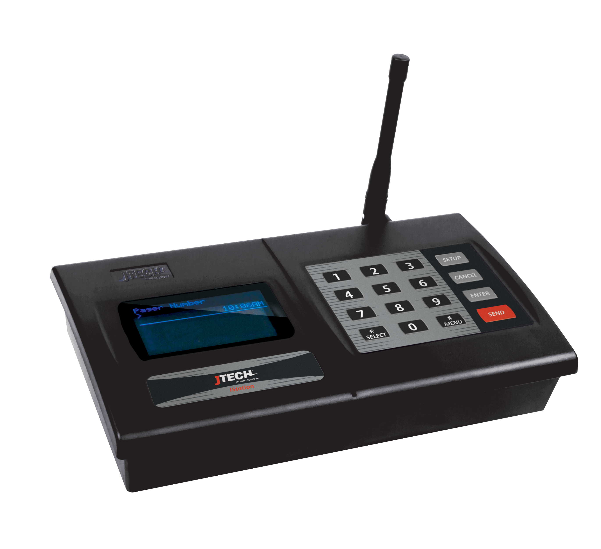
Istation
One Device for Every Need

Slide 2
Re-Imagine IStation
What?
  Embrace IStation as a backbone for all communication needs…
  Keep JTECH as the best provider of on-premise communication.
Why?
  Yes - we are seeing less demand for traditional paging systems…
  No - there is not a decreased demand for notifications on site.
    In fact, it may be more of a requirement with leaner operations.
How?
  IStation is not just a “paging transmitter” but the device for all your notification needs.

Slide 3
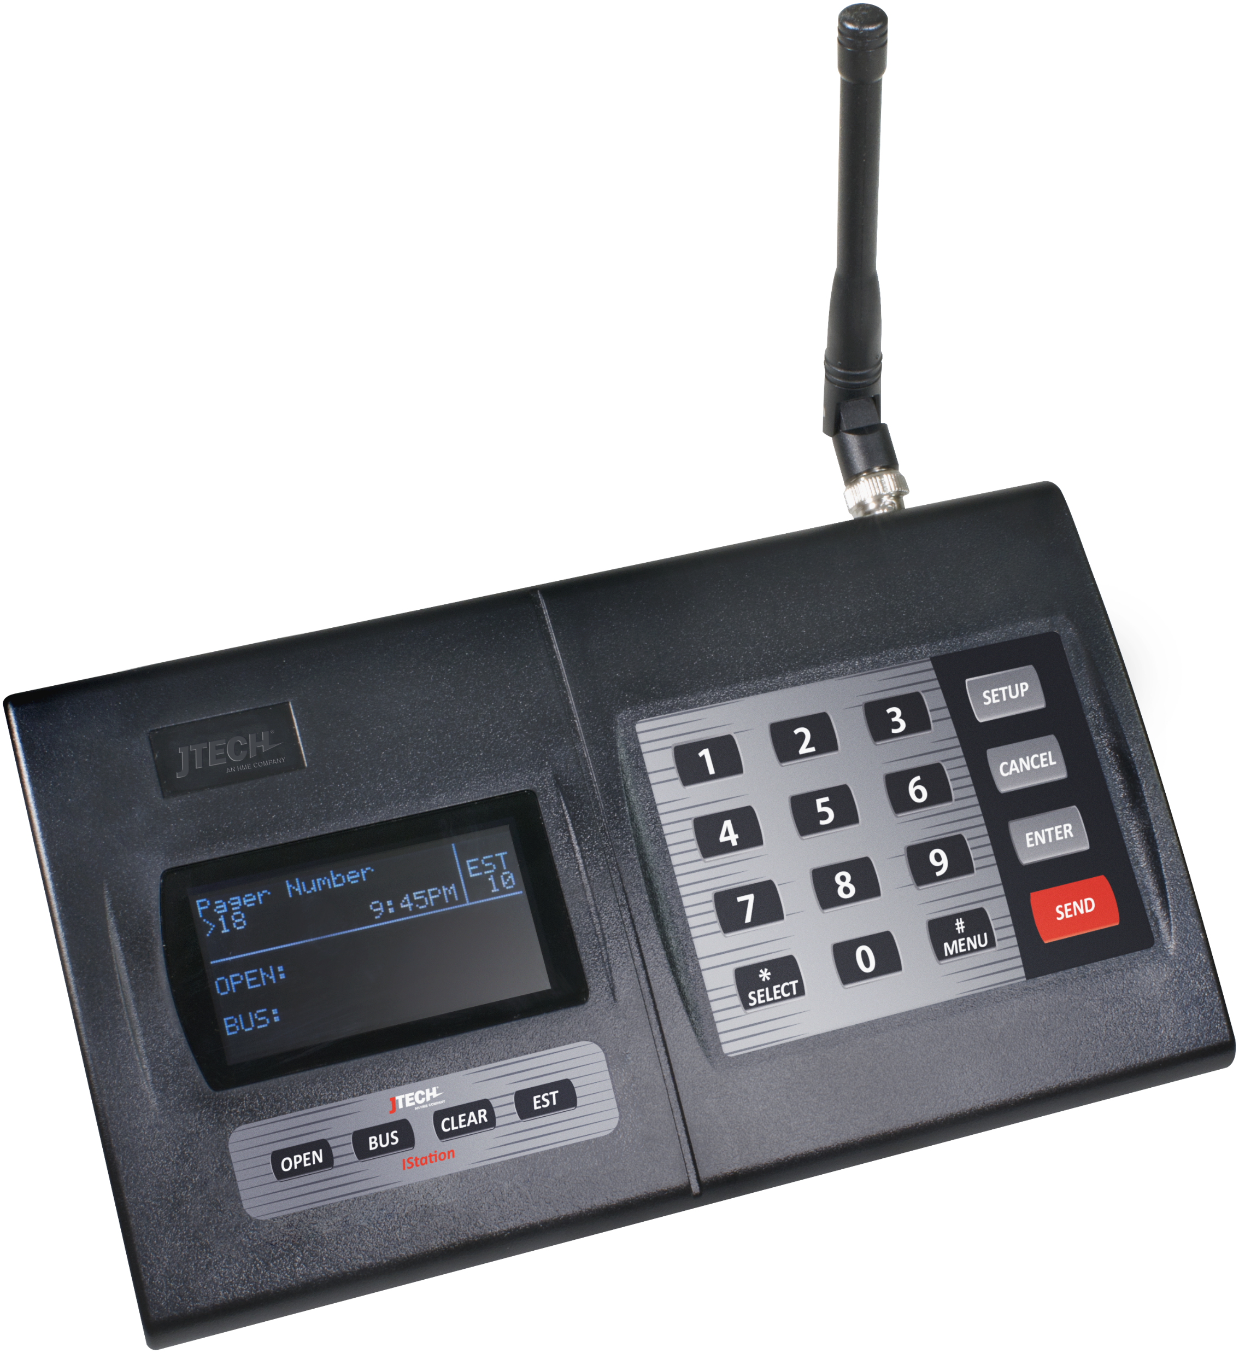
Did You Know?
1)
2)

Slide 4
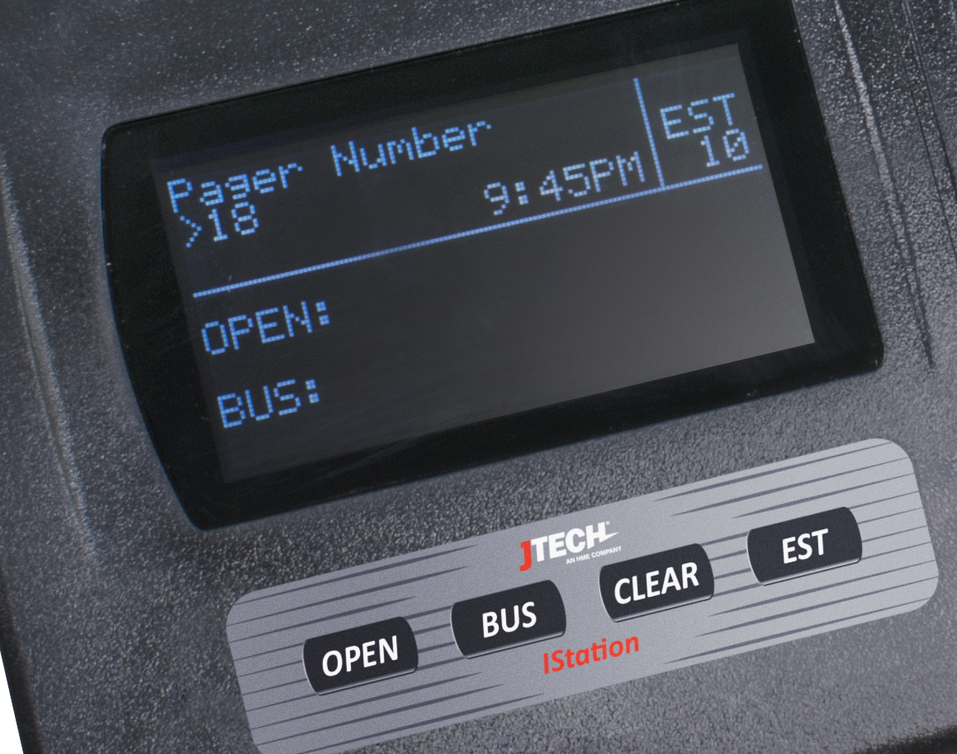
IStation with Hospitality Display
Basic Paging w/ALL Pagers
Lite Table Management
Four buttons under the display
    Open, Bus, Clear, Estimate
  EST adds time to with each press; removes with each sent page
  Works with TableScout

Slide 5
IStation with Standard Display
For ALL other applications
  Works with ALL Pagers
  Host Concepts, SmartCall Messenger
  ES Buttons w/Receiver
  MultiCast Network Paging
  Over the Air Repeater
  Teleconnect
  Alpha Messaging with Keyboard

Slide 6
Do You Know Everything IStation Can Do?
Standalone | Page JTECH legacy pagers. Page HMEW legacy pagers. Accept a USB Keyboard for alpha messaging. Send numeric or pre-canned messages by default. Be a repeater for Paging & Push Buttons Curbside or Restroom Alert | Mount on a wall. Connect to a High Gain Antenna. Be a Lite Table Management System. Be a wait time estimator. Receive updates from a TableScout. Manage ranges for alpha and non-alpha pagers separately. Send a Duty Alert to a pager at a pre-set interval. | Give a visual indicator when it receives a message over the air. Give a visual indicator when it sends a page. Receive and send on different frequencies. Tune to any licensed frequency between 420 ~ 470 MHZ for international use. That’s 2,000 possible combinations.
Connected | Via a Serial Cable: Kitchen Systems Table Management POS Systems Cruise line Systems Healthcare Systems ES Push for Service Buttons Display message strings to HyperTerminal or Putty Send TableScout updates to Aloha Guest Manager, QSR ConnectSmart Hostess, ESP System ProHost Add wireless sensors from Monnit Dry Contact Modules to trigger paging | Via a Phone Line: Page by dialing an extension Via Ethernet: Host Concepts SmartCall Messenger Custom built paging solutions Send SMS standalone and through Aloha Send TableScout updates to OpenTable Create a chain of transmitters via a wired network with MultiCast. Give you a visual indicator when that chain is broken.
And there is more on the way

Slide 7
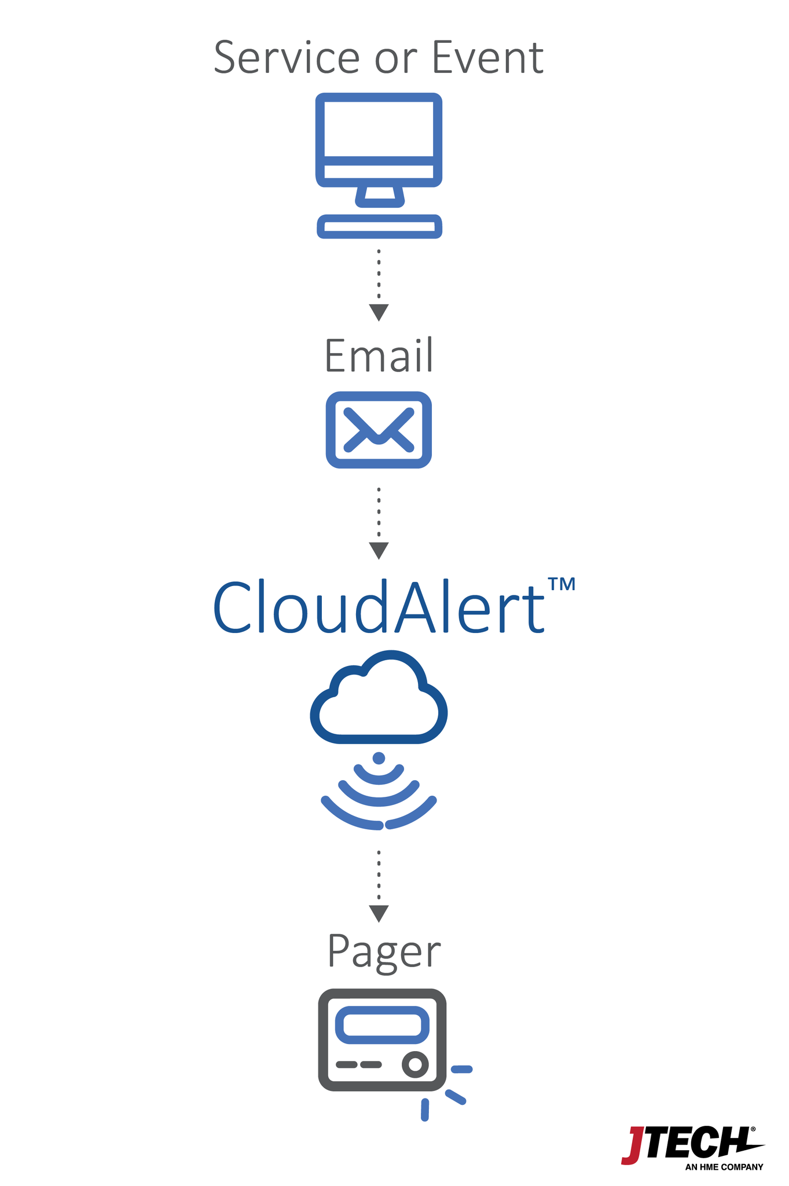
CloudAlert
New Cloud Feature

Slide 8
What is CloudAlert?
A mechanism where any 3rd party system can send us a message via email and we can convert it to a page.
Why email?
  Systems for years have used email (SMTP) communication to send messages to old wide-area pagers like 7705551212@archwireless.com.
  Current online order processors like Olo, BeyondMenu, GrubHub, Slice send notifications to recipients via email.
  Functionality is already built into these systems, no integration required.

Slide 9
How does it work?
Outside systems send an email to messages@jtech.com
We create a set of rules based on the email; sender, recipient, message details.
  Have a single pager device notified when any message arrives.
    A restaurant manager being alerted that a new online order has been placed.
  Parse the email for a specific pager number and alpha message.
    A patient is paged to go to a specific desk for registration.
CloudAlert server places the message in a queue for retrieval.

Slide 10
How does it work?
Customer’s IStation contains a specific Station ID and Token to authenticate with the CloudAlert server.
IStation polls the CloudAlert server every xx seconds requesting any waiting messages. (60 seconds is default)
Retrieves up to 5 messages per request, sends them to pagers.
Messages remain in queue until all transmitters retrieve them.
Can have multiple transmitters per site, up to 999.
Works with alpha and non-alpha pagers.

Slide 11
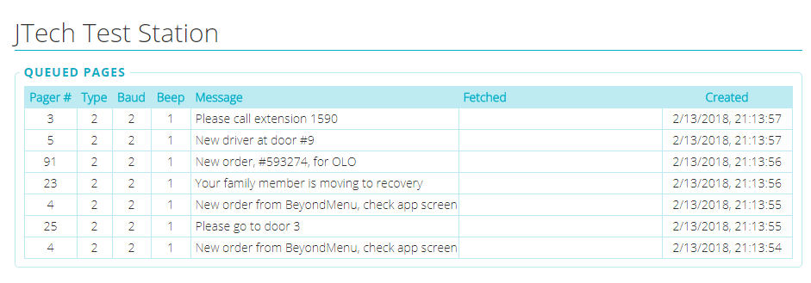


60 sec
60 sec
60 sec
Station ID: jtech003
Station ID: jtech001
Station ID: jtech002

Slide 12
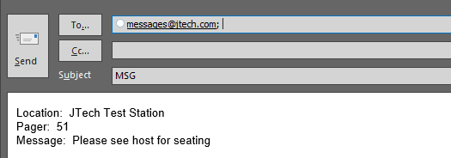
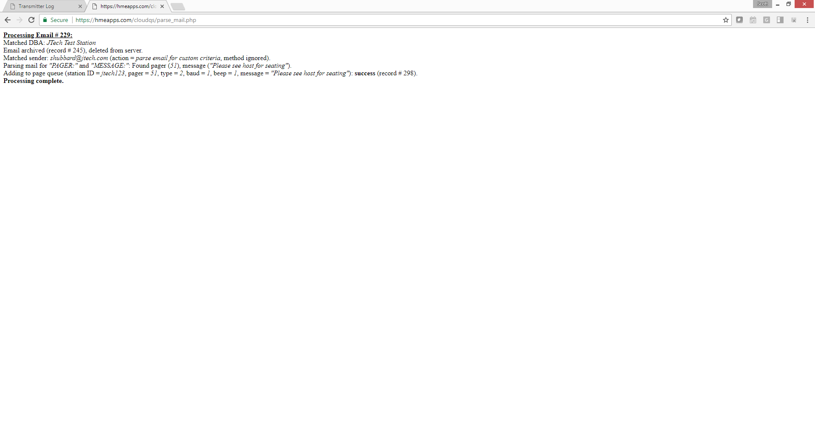
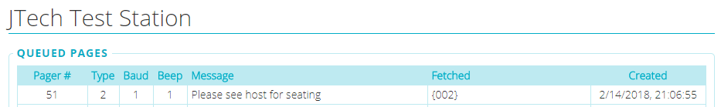
❶
❷
❸
❹

Slide 13
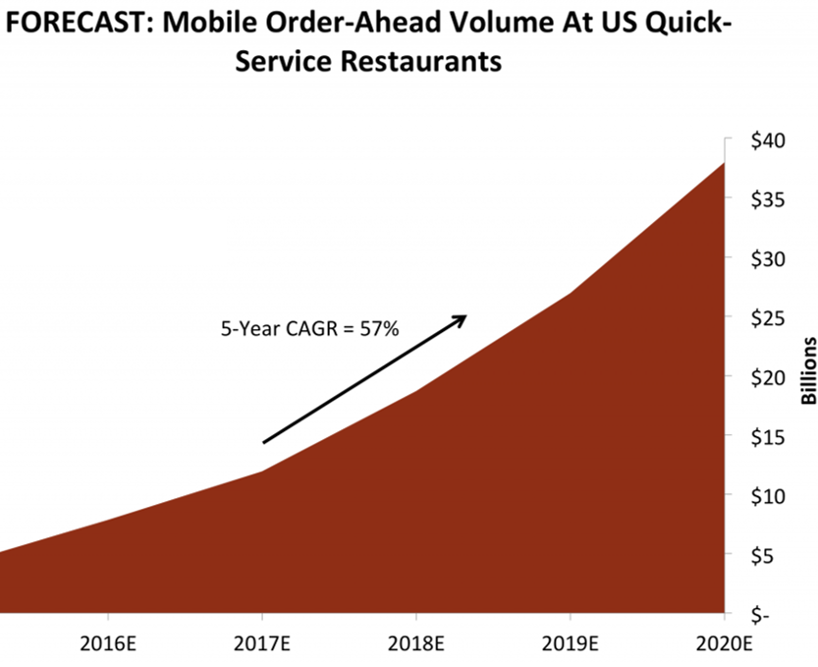
What is the upside?
Opens door to mobile ordering providers who are now using email as their communication vehicle to restaurants.
  GrubHub, OLO, Revel, Slice
  Untapped markets like Pizza, LSR, Family Style that are served by online order providers

Slide 14
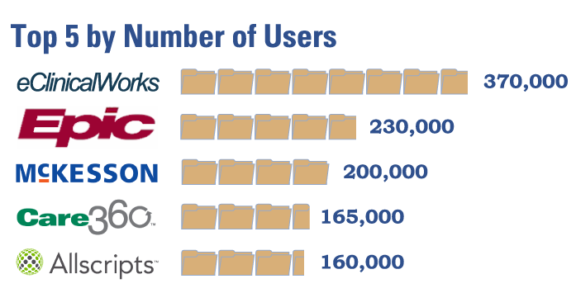
What is the upside?
Opens door to all legacy 3rd party software applications have already have SMTP outputs.
  EMR Providers in Healthcare

Slide 15
What is the upside?
All connections are secure, transmitter is reaching outbound.
  No network “pinhole” to exploit.
  No less secure than going to www.cnn.com
Removes barriers to integration.
  Instead of writing code and testing against our hardware. Partner only needs to produce an email.
Will eliminate browsers handling mixed content in SCM.
  Since the browser is no longer involved, no blocking of mixed content.
  Required SCM updates will be completed before March 1.

Slide 16
CloudAlert
CloudAlert Service Resell Pricing:
  $240/yr. billed annually. P/N: SWCAAR
Setup Fee: $49 one time. P/N: SWCASET
Requires IStation connected to internet.
  Firmware version 2.42 or higher with memory chip
  Need to request in notes until existing stock has been liquidated.
Requires a sample email send to us for setup.

Slide 17
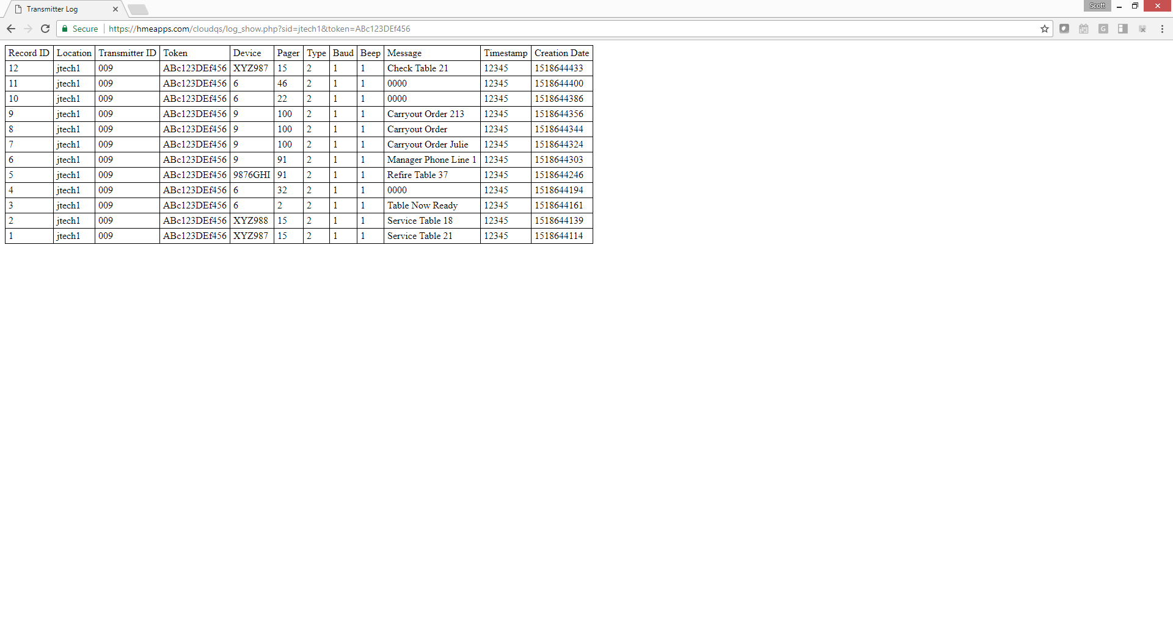

Data logging
New Cloud Feature
Station ID: jtech1009

Slide 18
What is Data Logging?
A mechanism where all on-site notification information is pushed to the cloud in real time.
  Pages from an IStation directly to pagers.
  Other commands sent from other devices like TableScout, Service Buttons, Restroom or Curbside Valet that are “heard” from the IStation receiver.
Data will be stored for up to 180 days in the cloud for retrieval.
Retrievable with a web browser by the client for review.

Slide 19

How does it work?
Each IStation will have a two-part unique ID.
  Client ID and Token:
    Location: 3-6 character client ID
    Transmitter ID: 3-digits (001-999)
    Token: 12 characters, case sensitive
Each device that initiates a notification can have it’s own ID, which will be logged with the message and a timestamp.
  IStation, Push Button, ServerCall, TableScout
jtech1 009 ABc123DEf456

Slide 20
How does it work?
IStation can store up to 2,800 records in memory if connection is lost with internet.
Today it is just a simple log, but will be the platform for many future development projects.

Slide 21
What is the upside?
Understand traffic occurring in the facility.
Different use cases.
  General Activity log
  Pilot Testing evaluations
  Response Times
  Cancel requests
  Escalation requests, call for manager
Future ties in with waitlists and location activity.

Slide 22
Data Logging
Data Logging Service Resell Pricing:
  $240/yr. billed annually. P/N: SWDLAR
Setup Fee: $49 one time. P/N: SWDLSET
Requires IStation connected to internet.
  Firmware version 2.42 or higher with memory chip
  Need to request in notes until existing stock has been liquidated.
Requires a us to provide client ID and token before use.

Slide 23
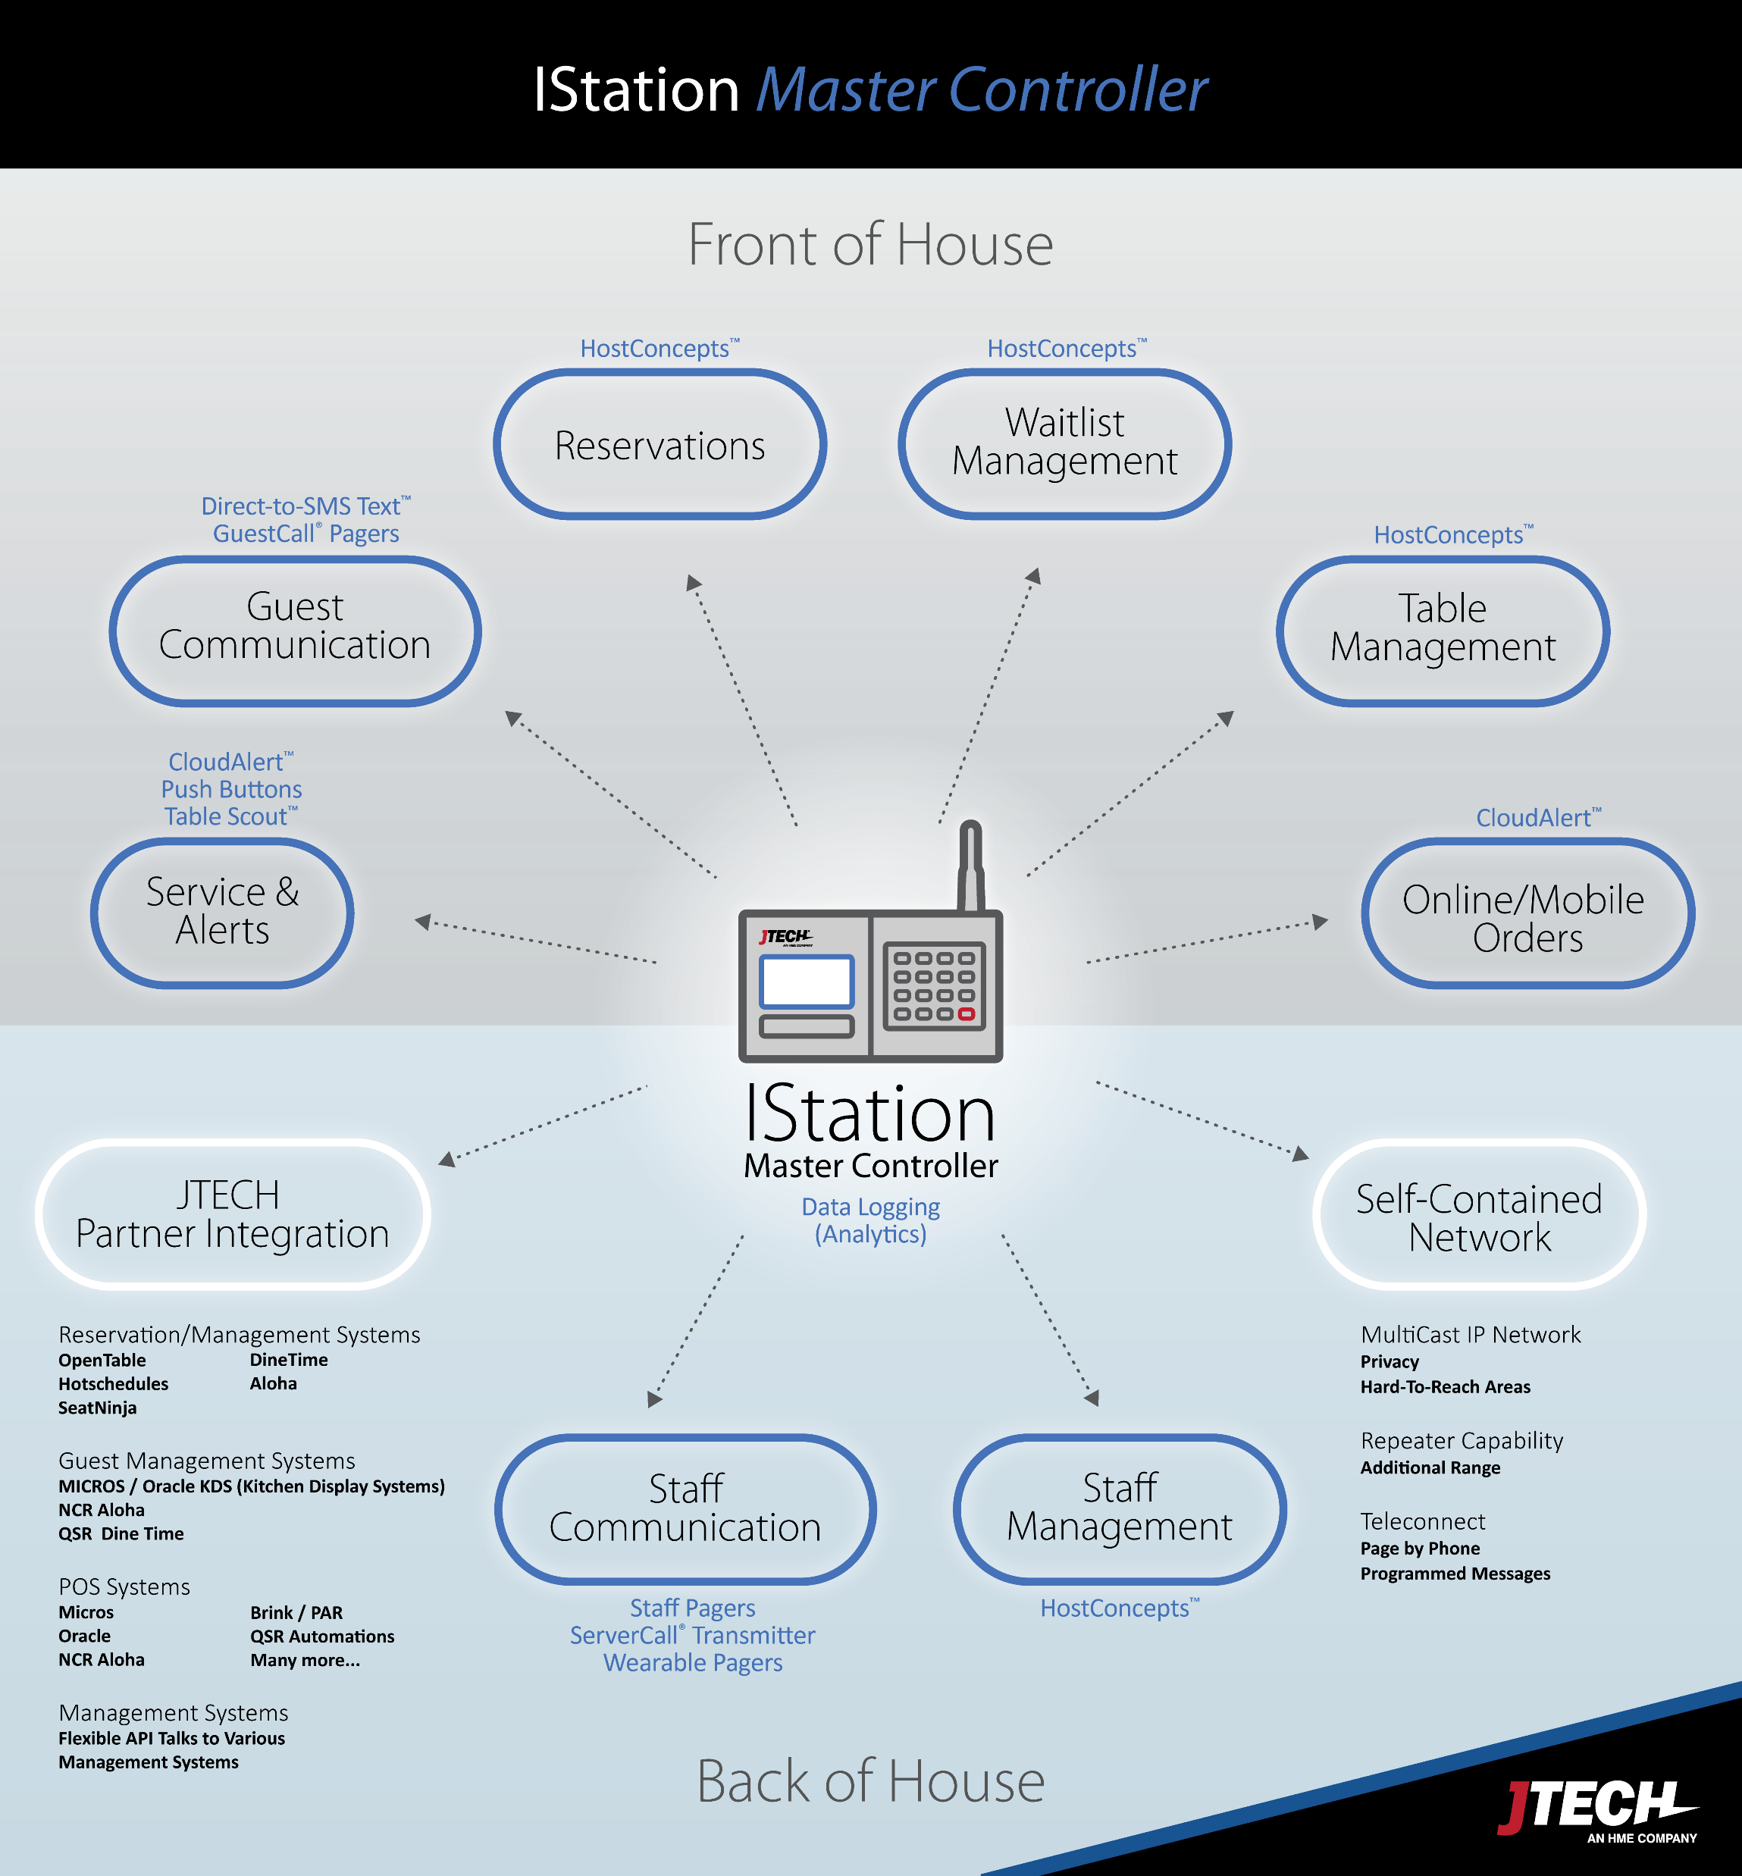
Istation
One Device for Every Need

Slide 24
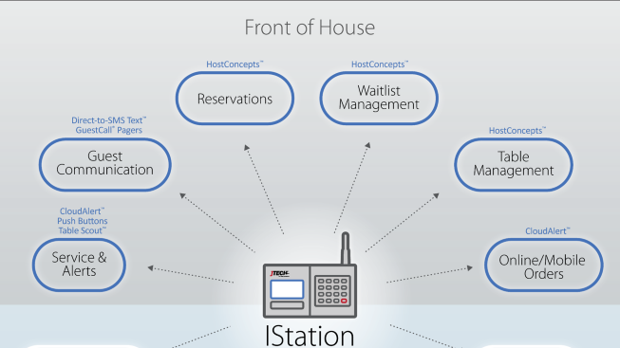
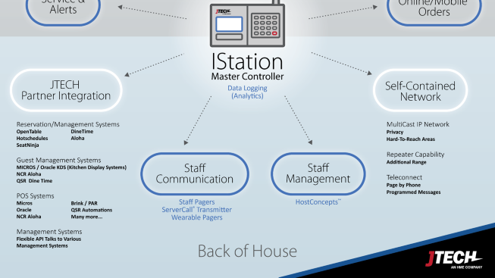
“Master Controller” ??
IStation is the center of your communication universe.
Today it may be guest or patient paging.
Tomorrow…
  Integration to another system
  SMS
  Messaging to wearables
  Add on efficiency tools like TableScout or Push Buttons

Slide 27
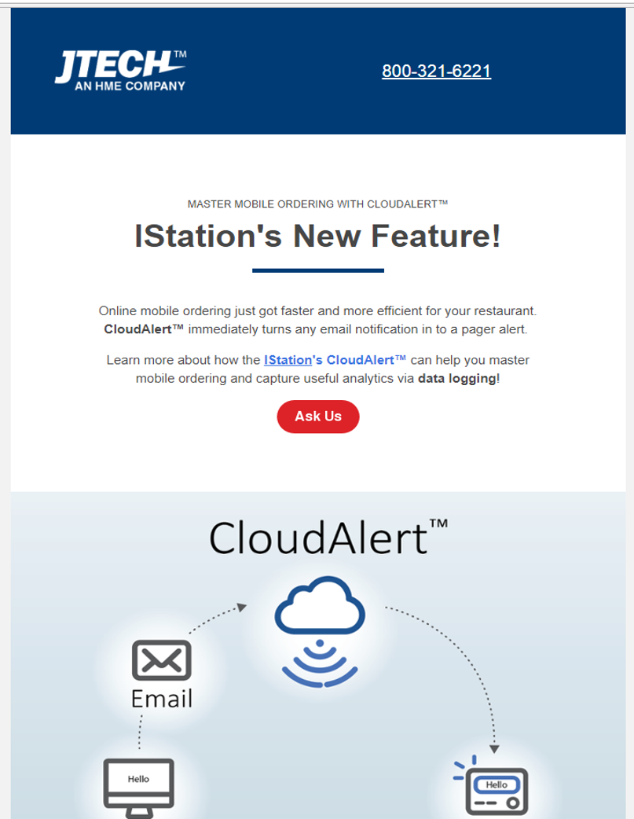
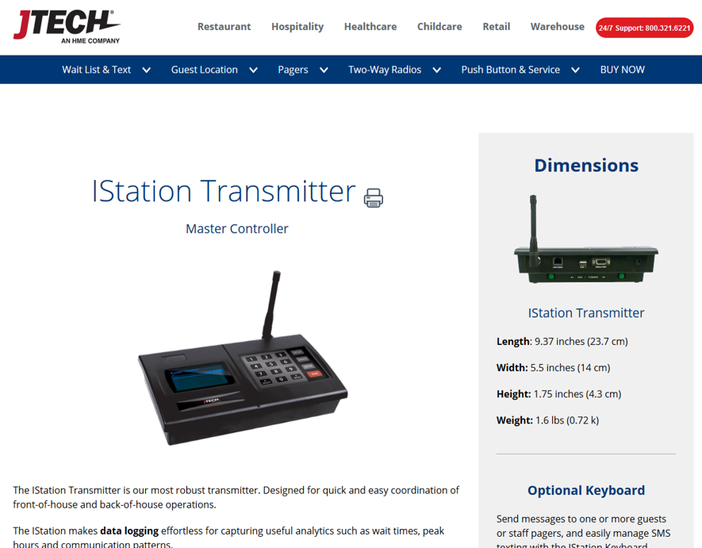
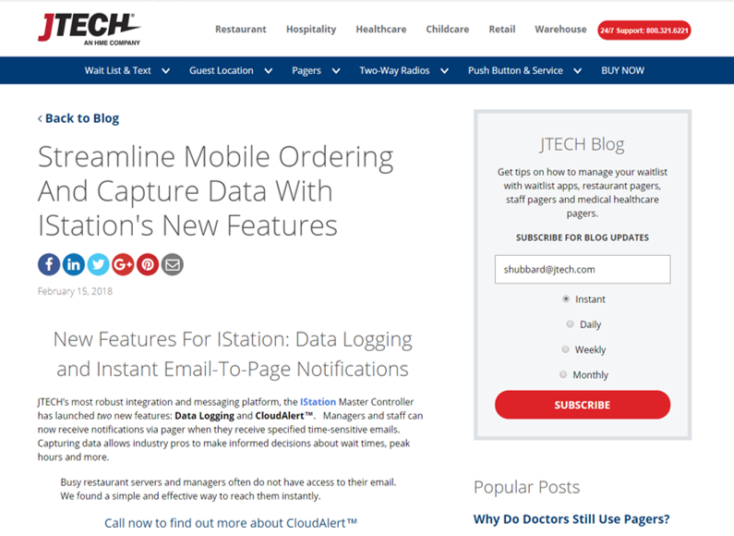
Istation
Public Awareness

Slide 28
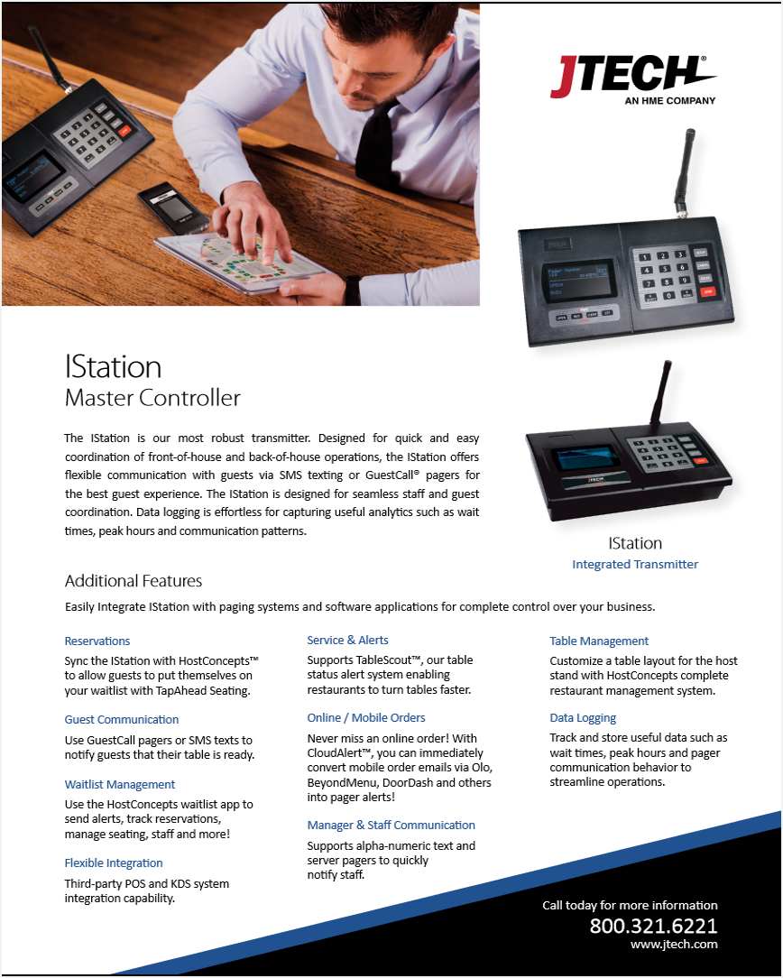
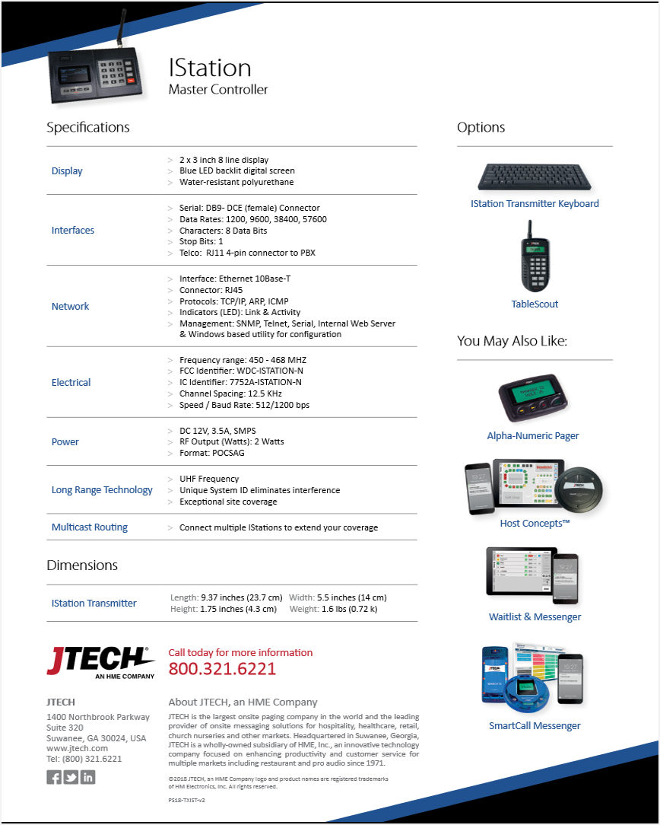
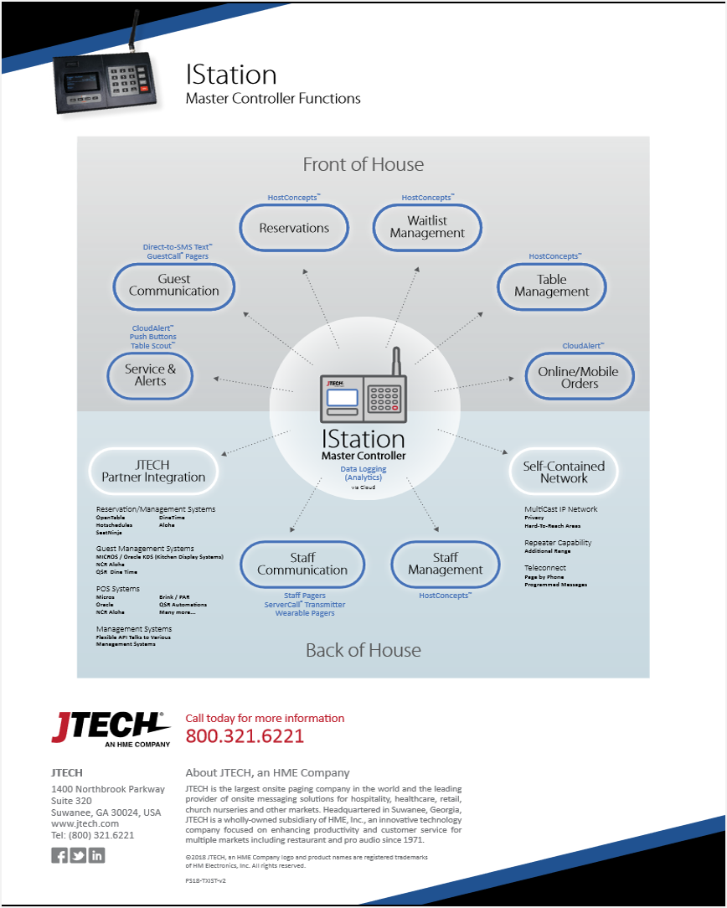
Istation
New, Specific Datasheets

Slide 29
One Device for Every Need
Direct Paging ☑
Alpha Paging ☑
Lite Table Management☑
Serial Connections ☑
Telephone Connections ☑
Ethernet Connections☑
Repeater☑
Network Paging☑
Cloud Paging☑
Integrations to over a dozen 3rd party systems☑
Upstream data logging ☑
No like for like Competition ☑
List Price: $995

Slide 30
Istation
 | Price | Description | PART NUMBER
IStation | $995 (MSRP) | ISTATION Master Controller | ISTATION
CloudAlert | $240/yr. | CloudAlert Software Service – Annual Renewal | SWCAAR
 | $49 setup fee | CloudAlert Software Service – Setup Fee | SWCASET
Data Logging | $240/yr. | Data Logging Cloud Service – Annual Renewal | SWDLAR
 | $49 setup fee | Data Logging Cloud Service – Setup Fee | SWDLSET
Interested in a demo account?
Contact your Channel Manager or email us at sales@jtech.com
Summary

Slide 31
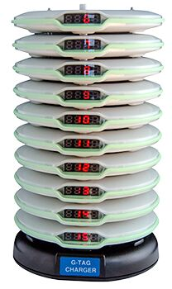
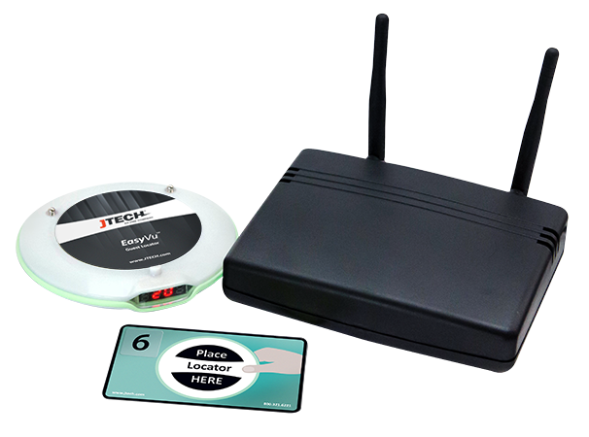
Easyvu
Location System

Slide 32
EasyVu
EasyVu is our exciting and new table location system. It is our entry-level system
that falls in the family of our current Vuze Table Location system. EasyVu locates
guests and tables on demand for faster food delivery. EasyVu can also be used as
a pager system to call customers back to the counter. The system uses a NFC
(Near Field Communications) tag allowing for 100% accuracy. EasyVu is a self-installed system that gives our customers freedom to grow their businesses.

Slide 33
Why EasyVu?
I’m glad you asked… EasyVu exist today because of our award-winning Vuze Table
Location System (Winner of the 2016 QSR Magazine Applied Tech Award). Vuze is an industry pioneer that set the standards for locating guest
on the hospitality scene. Vuze is located in more than 2000 locations abroad and has
made multi-millions of dollars for the company. We’ve only scratched the surface with
Vuze. We have listened to our customers, overcame our table/guest location challenges
and went back to the drawing board. We’ve found an affordable solution that allows
ALL customers the opportunity to maximize their guest experience…….
Today, we introduce our new entry-level table location system… EasyVu

Slide 34
Components
EasyVu Tablet … Windows 10 2-in-1 Notebook / Tablet that will display locations
Guest Locator … Locator / Pager given to the customer to carry to the table
Charger … Stackable housing for Guest Locator
Table Tag … Durable plastic adhesive card that sticks to the table, talks to Guest Locator
Gateway … Brain hub that stores and transmit location information
Software … Internal ingredients that runs the system
Table Tag Writer (Optional) … Optional to the customer. Programs all Table Tags

Slide 35
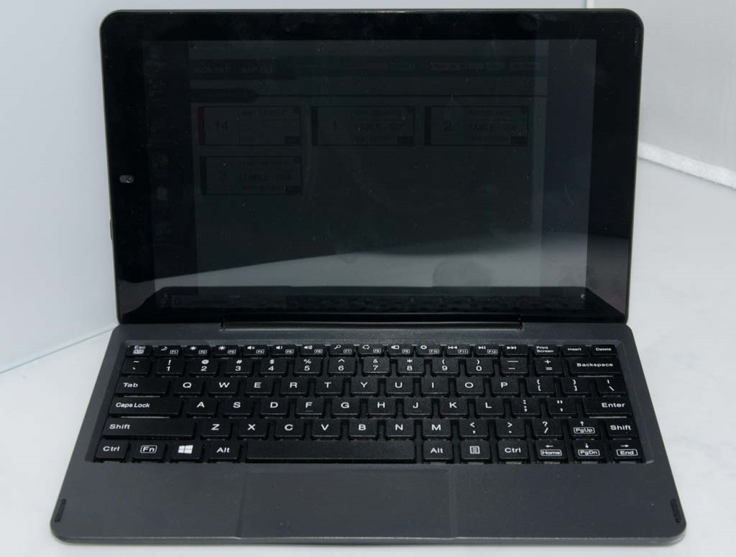
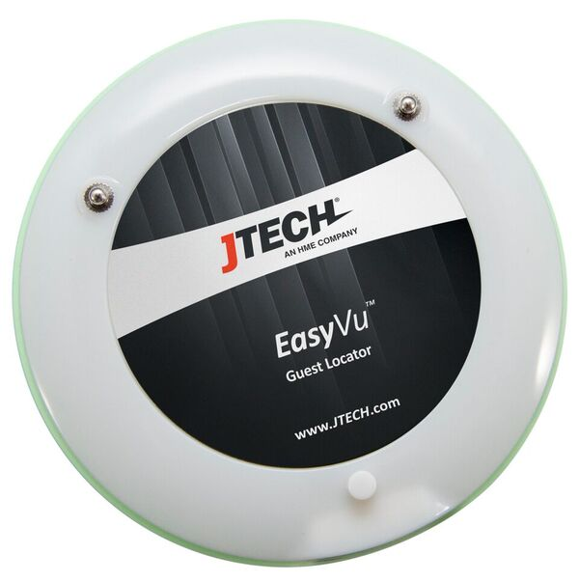
- RCA Cambio 2-in1 notebook / tablet
- Windows 10 / 10” display
- USB 3.0 port / Micro USB port
- Battery life up to 6 hours
- Diameter: 105 mm
- Thickness: 15 mm
- Weight: 102g
- Battery: Lithium / 12-14 hours off charge
- Out of Range Notification
- Alert Type: Vibe / Flash / LED / Find

Slide 36
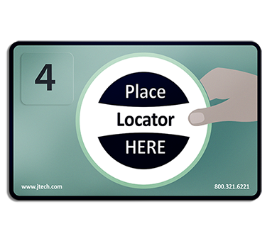
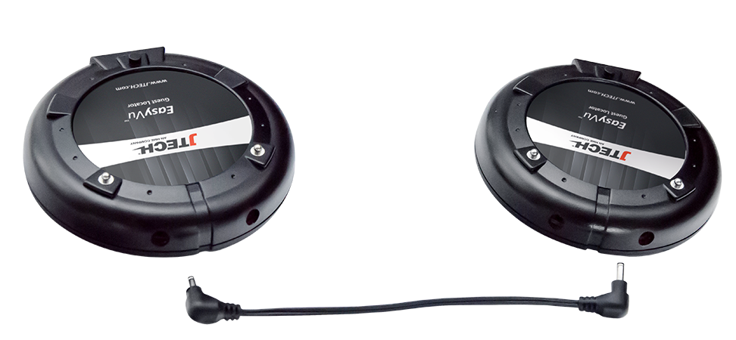
-Length: 54 mm
-Width: 85 mm
-Weight: 5g
-Durable Plastic (adhesive)
- Diameter: 105 mm
- Thickness: 20 mm
-Weight: 90g
-***DIFFERENT CHARGER FROM “CHAR”!

Slide 37
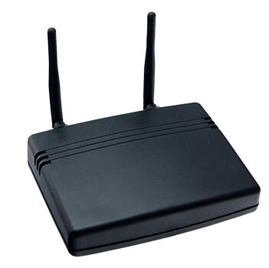
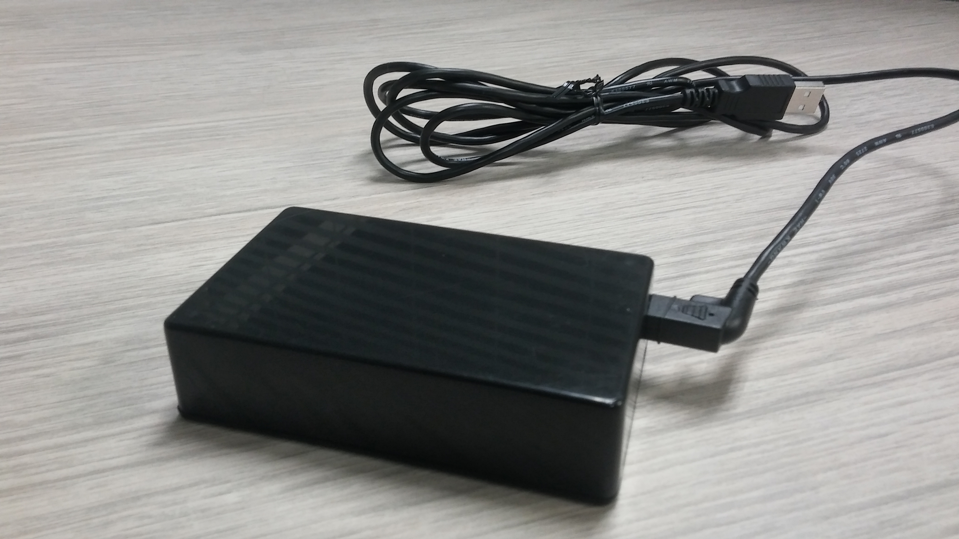
Length: 4.5 inches (116mm)
Width: 5.5 inches (140mm)
Height: 1.4 inches (37mm)
Weight: 185g
Carrier Frequency: 420-470 MHZ
Range: Up to 250 meters
Table Tag Writer is OPTIONAL
All table tags will be programmed in production during system set up

Slide 38
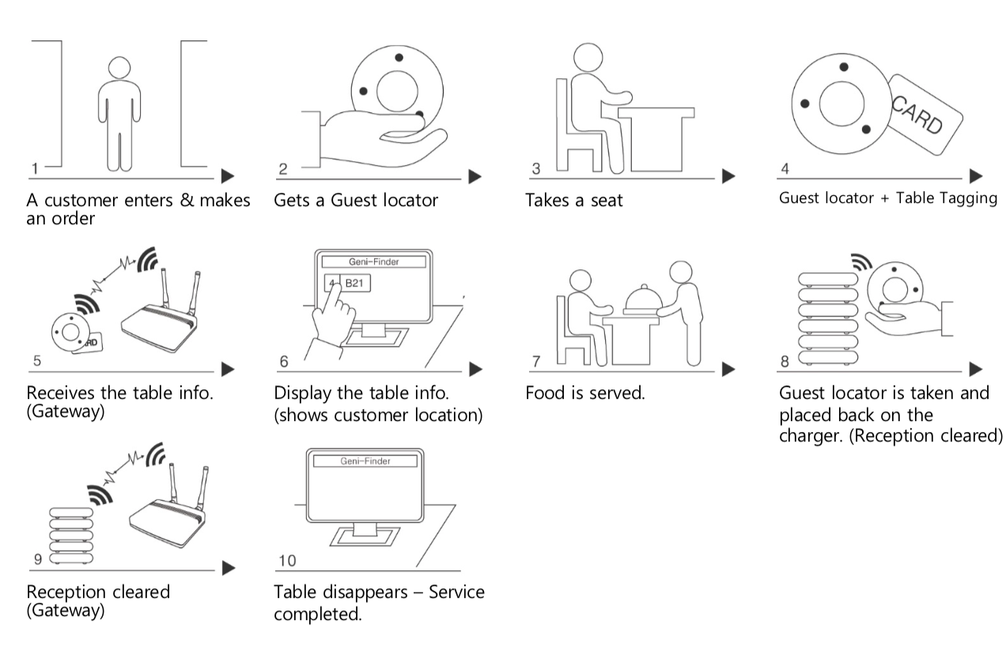
How Does EasyVu Work?

Slide 39
Let’s take a closer look
EasyVu

Slide 40
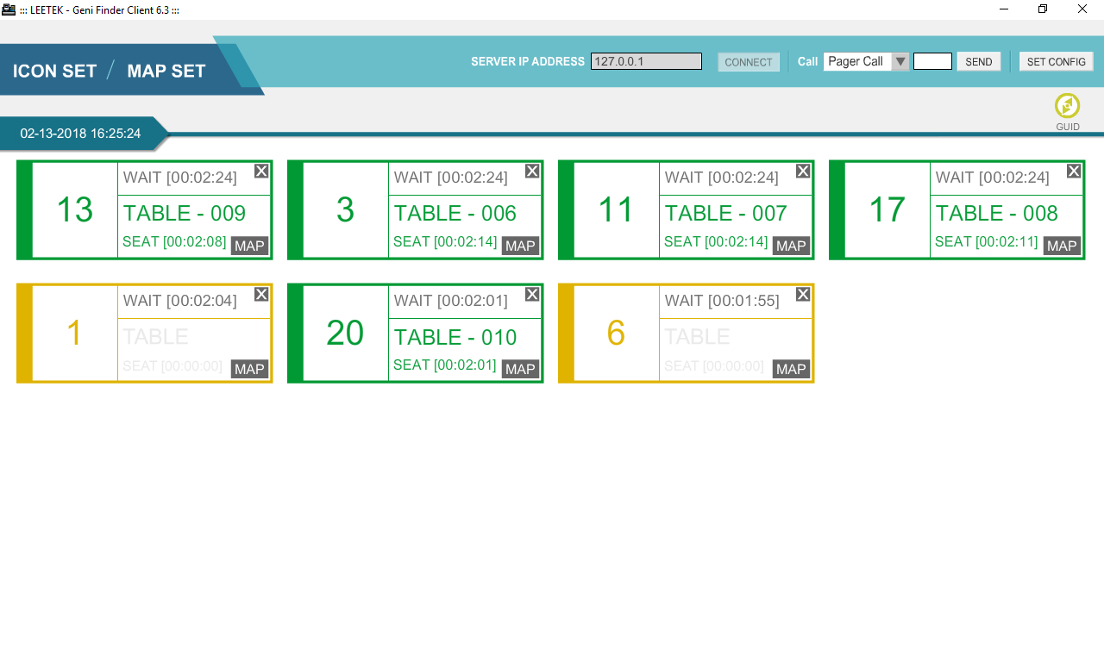

Slide 41
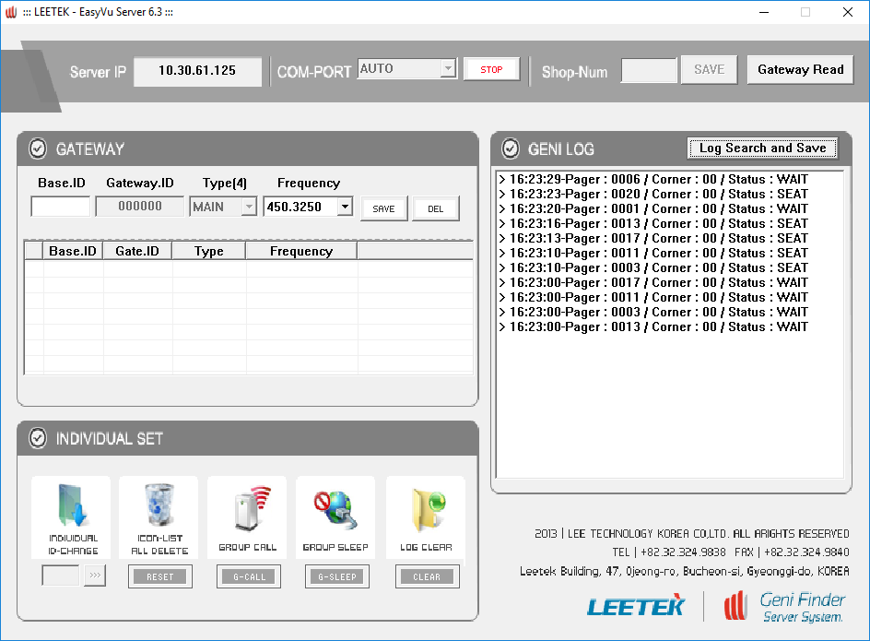


Slide 42
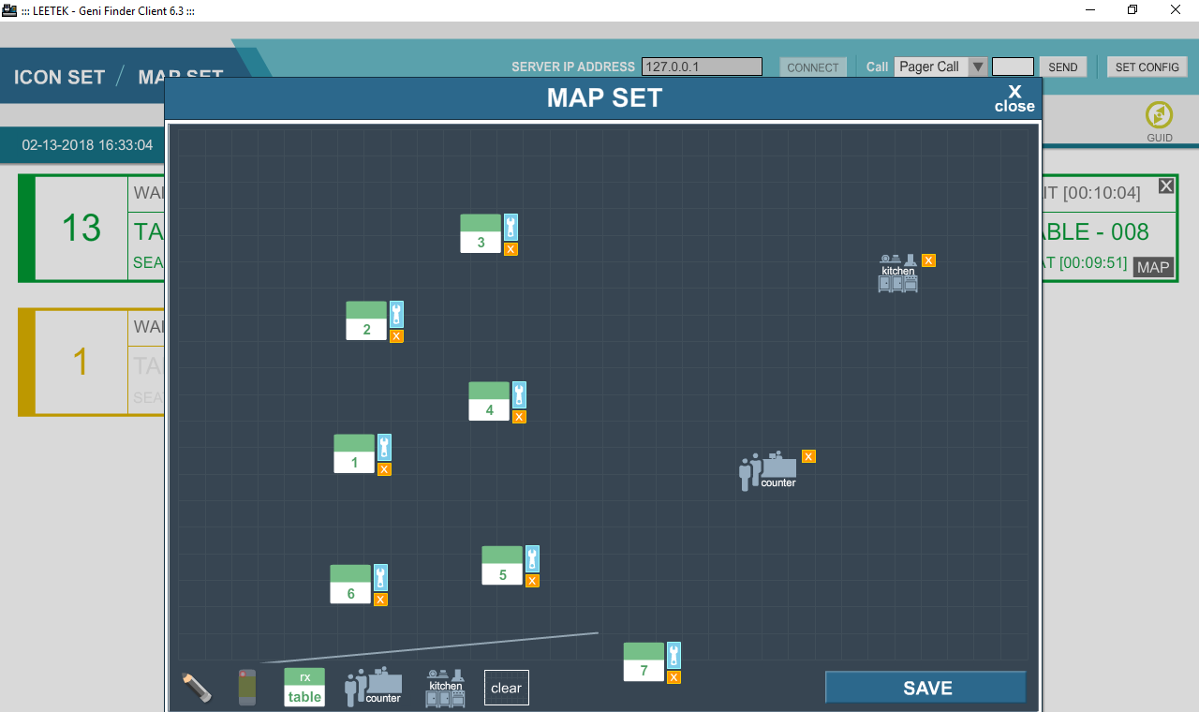

Slide 43
Part Numbers
Description | PART NUMBER | MSRP
EasyVu Tablet | ACEVTAB | $500
Guest Locator | PGEVGT | $99
Charger | CHEVB | $99
Table Tag | PGEVTT | $6
Gateway | TXEVGW | $450
Software | SWEV | $300
Table Tag Writer | ACEVPRG | $300
See your JTECH Representative for pricing

Slide 44
Guest Tag Customization
GUEST TAG
The guest tag for EasyVu will come with the JTECH decal that was created internally.
The JTECH decal will say EasyVu Guest Locator.
The diameter is 2.75 round.
We will use our standard process of shipping the guest tags with our JTECH decal.
Customized guest tag decals can be purchased for $3 each, at the cost of the customer.
Customized decals will need to be listed on the sales order, using the part number VUDECAL.
The salesperson will be responsible for getting artwork and any details from the customer.
The artwork should be in a JPEG or Adobe file.
There will be no minimum quantity orders.
The lead time for customized guest decals will be 3-5 days.
Decals will be prepared by our production team.
The customer will also have the option to send us their branded decals.
Pre-printed / branded decals will need to meet all requirements.

Slide 45
Table Tag Customization
TABLE TAG
The table tag for EasyVu will come with the standard artwork that was created by JTECH.
The table tag is a durable-plastic adhesive card.
The dimensions for the table tag is 54 mm x 85 mm.
Our process will be to ship standard table tags with each sales order.
Customized table tags can be purchased for $7 each, at the cost of the customer.
Customized decals will need to be listed on the sales order, using the part number PGEVCTT.
The salesperson will be responsible for getting artwork and any details from the customer.
The artwork should be in a JPEG or Adobe file.
There will be 50 minimum quantity orders.
The lead time for customized table tags will be up to 3 weeks (these come from Asia)
The table tags will be prepared by our production team.
The customer may be able to use pre-printed / branded artwork for table tags. Artwork will need to meet all requirements.

Slide 46
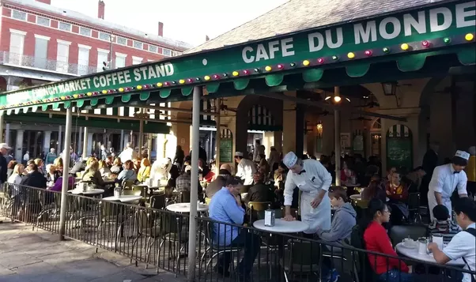
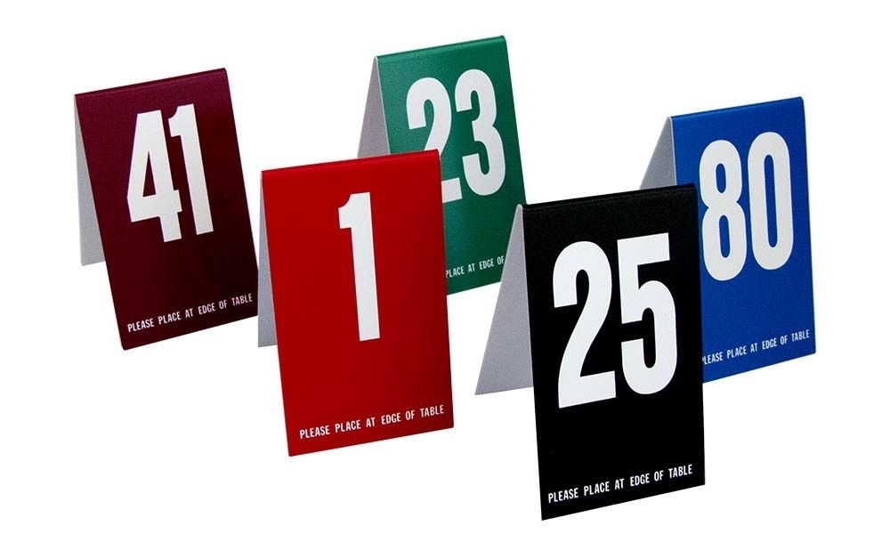
Value Propositions

Slide 47
Value Propositions
Deliver hot food hot and cold food cold…don’t keep your guest waiting
Identify / Locate where your guests are with 100% accuracy
Self-Installed / Easy to use / Freedom to grow your business
Improve your guests Experience, keep your guests coming back to your restaurant
Improve food runner productivity…stop the run around trying to find table tents
Improve efficiency…shave minutes off time of food delivery…save time / save money
Less expensive than ANY high performing table location system on the market
System can be used for table location or a paging system (return to the counter)

Slide 48
Value Propositions
Data Log capability to help analyze your service and drive your business
Table Tags will sit “on top” of your tables to allow the system to locate your guest
with 100% accuracy.
We offer customized Table Tags with your branding
If you absolutely do not want table tags on top of your table, we have another system
that will locate your guests. It may better serve your business. It is VUZE!
The EasyVu system has a huge range of 700 ft outdoors / 400 ft indoors
The EasyVu system has the capability of using multiple gateways to extend coverage
Map feature allows you to draw your own store location to assist food runners
#1 Product Quality and Customer Service

